Slide 1
Environmental Computing with R
GEOG 473-673
Professor James Simkins

Slide 2
Welcome!
This is designed to be a crash course in R. We only have 8 classes together so we’ll be moving at a fast pace, but I hope to teach you to use R…or at least different techniques and resources you can use to help advance your own R knowledge!

Slide 3
What is R?
R is a open-source (free) programming language created for statistical operations but extended for use in other areas
Because it’s open source, anyone can contribute new functionality to R in the form of a package
Tools that R can be used for are done so via scripting/programming as opposed to a ‘point and click’ method that ArcMap uses

Slide 4
What does R do?
Data handling and storage: numeric, textual
Matrix algebra
Spatial data reading, manipulating, writing, reprojecting, etc.
High-level data analytic and statistical functions
Plotting, graphics, movies
Everything Microsoft Excel does except faster & better

Slide 5
R vs. RStudio
R is the interpreted computer programming language we’ll be using in this section of the course
Rstudio is the IDE (integrated development environment)
It’s just a fancy ‘app’ that is built on the R programming language and provides layouts that make programming more visual & intuitive

Slide 6
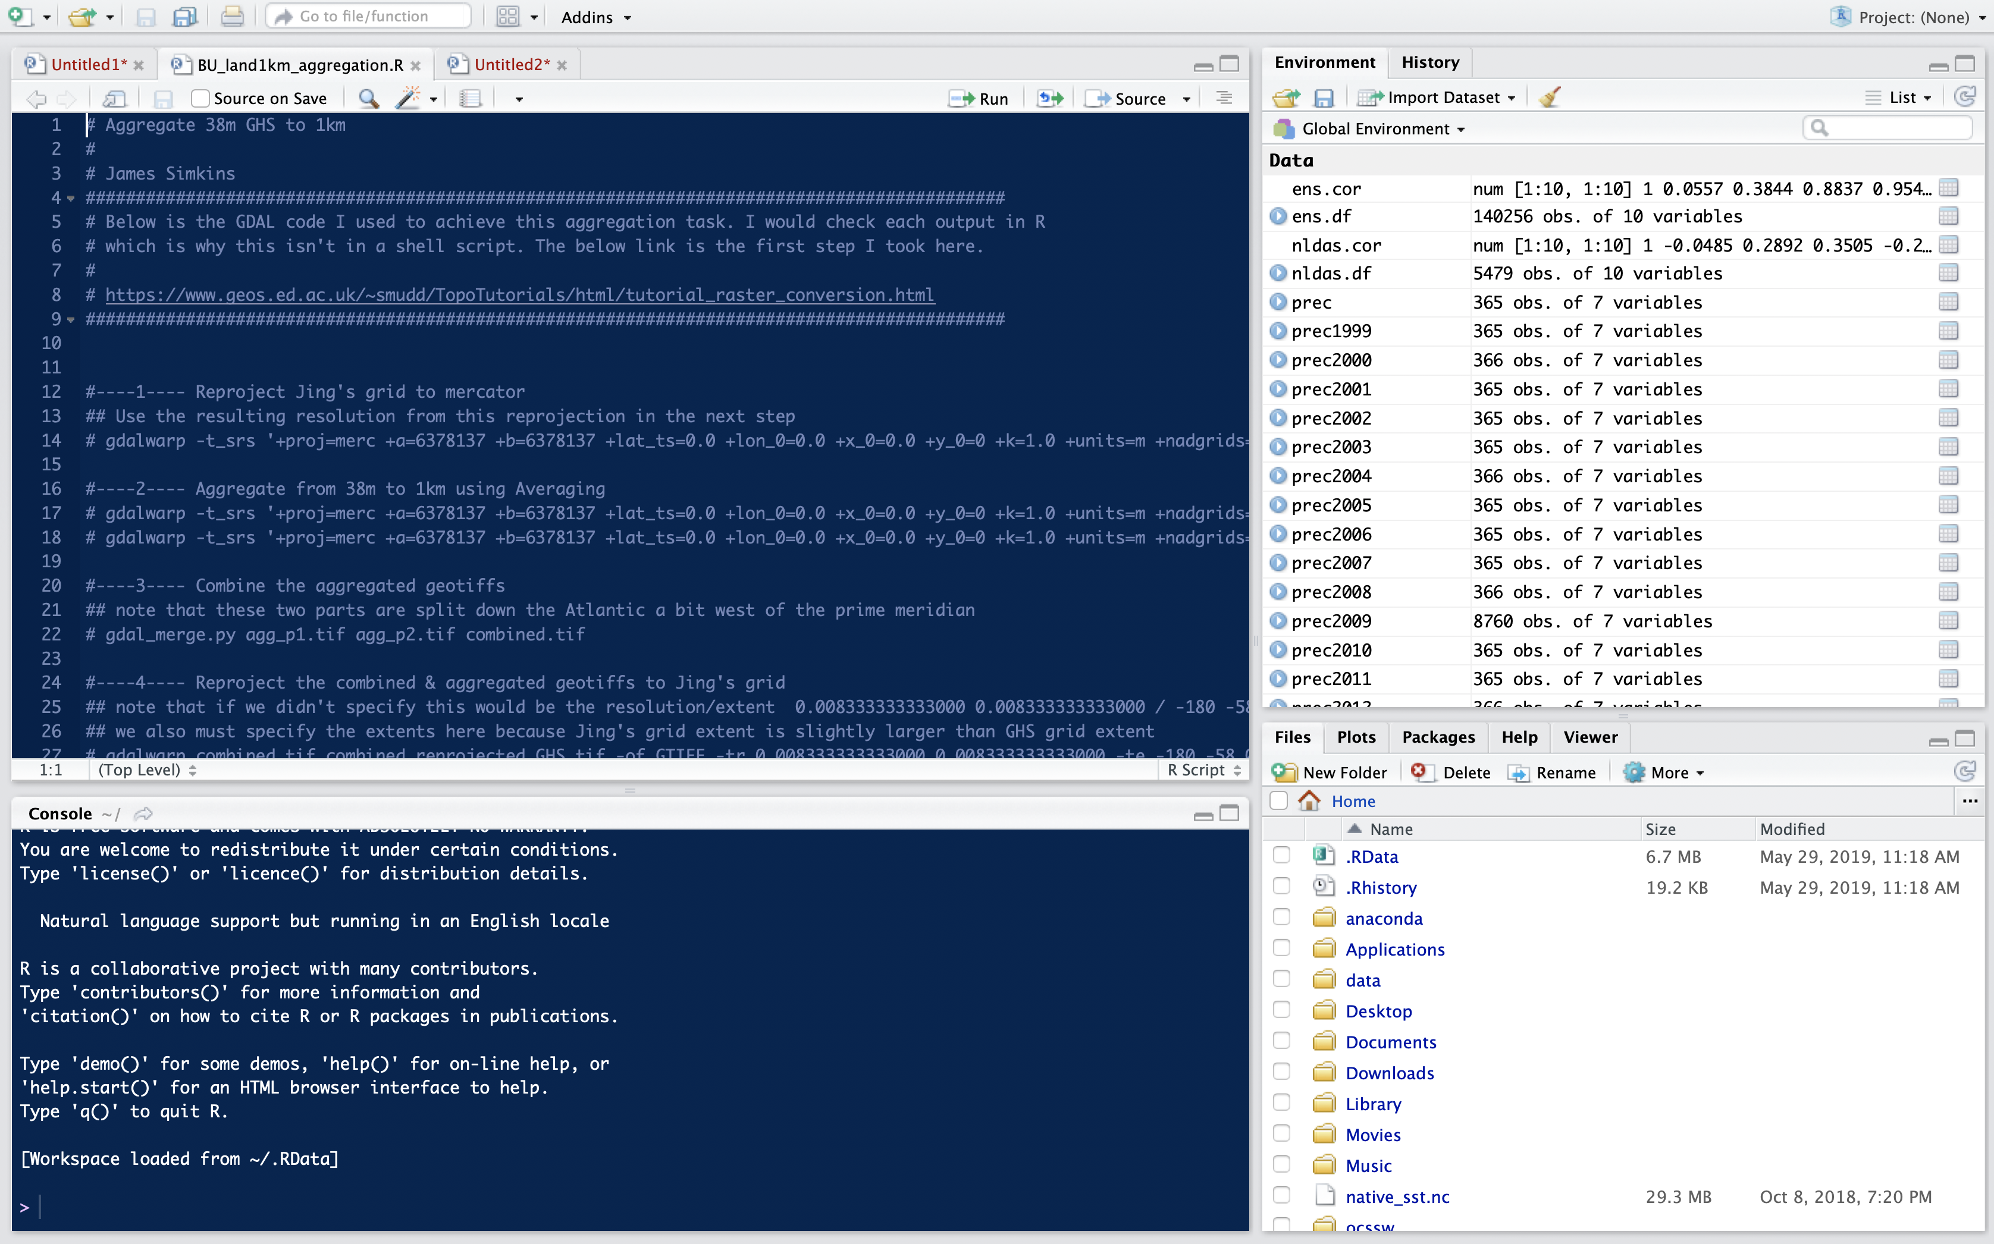
Rstudio
Script
Variable Environment
Console
Files, Plots, etc

Slide 7
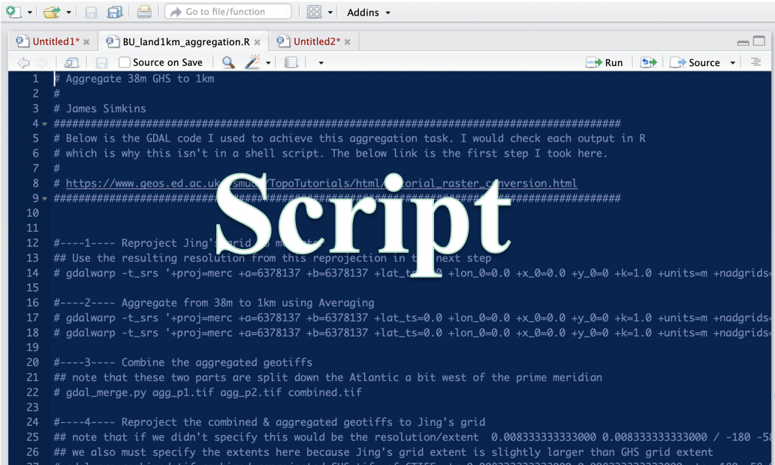
Script
An R script is basically the rough draft of your Microsoft Word Document.
It’s your canvas that you’re constantly adding to, editing, tweaking, or removing.
Always save a script as ‘script.R’

Slide 8
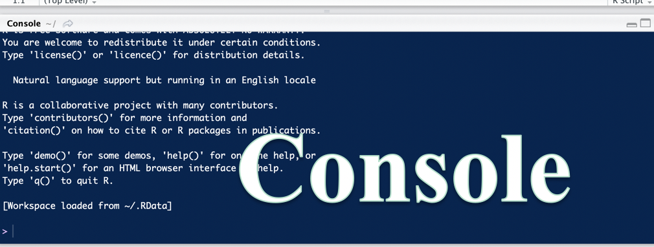
Console
This is where you test what you’re writing to see if it works or not
Easiest way to test a line of code out in console is to move cursor to that line and select ‘Run Line’ or simply ‘cmd + Enter’ for mac or ‘Control + Enter’ for Windows/Linux

Slide 9
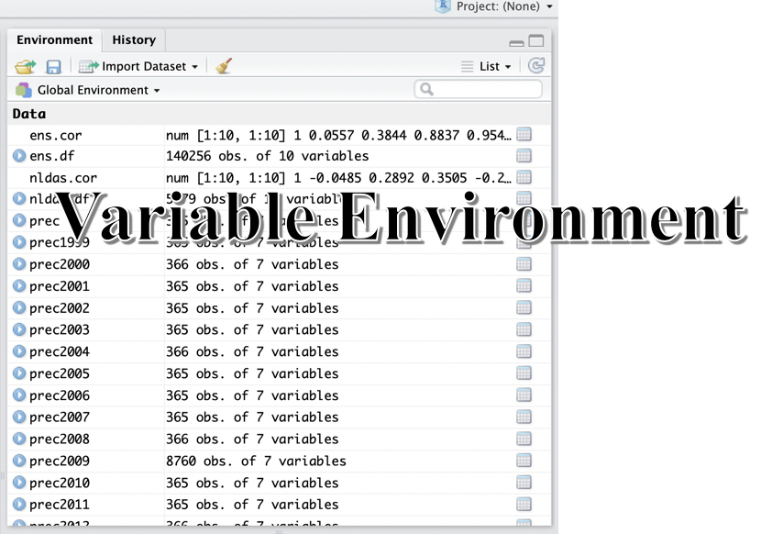
Variable Environment
Whenever you declare an object (x=10), load a dataset (datafile = data.csv) it will appear here to show you it exists and give you an idea of shape & size

Slide 10
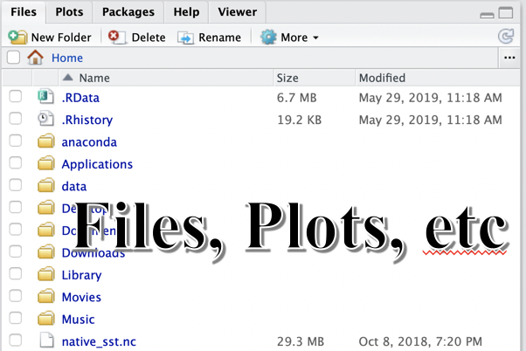
Files, Plots, etc.
Just a nice visualization of your documents, directory (folder or place where other folders are stored), plots, loaded packages & available packages

Slide 11
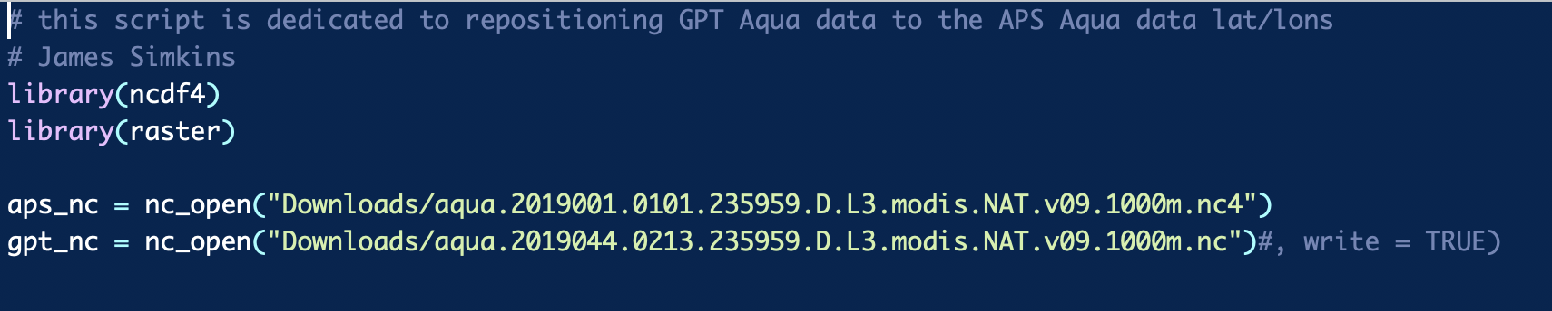
What’s a package?
A suite of functions (like mean(), median(), nc_open() ) that someone else already wrote so you don’t have to recreate the wheel everytime you want to do something with data
You need to call these packages at the top of the Rscript so R knows it has to use them to execute code below

Slide 12
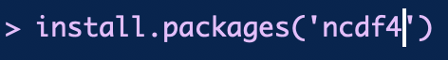
What if I don’t have a package?
You’ll need to install these packages manually (in the console) and then load them to your script (by typing library(ncdf4) in your script)

Slide 13
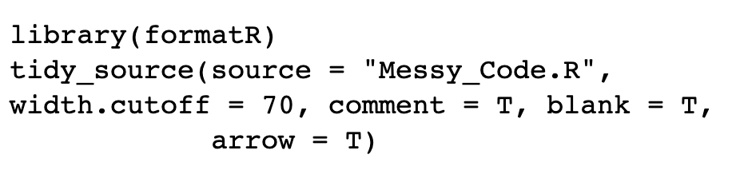
Other things to note…
To declare an object (x=10, or datafile = ‘data.csv’), traditional R users use ‘<-’ instead of ‘=‘.
You can use either. I use ‘=‘ because it’s more intuitive.
PS, if you’re ever turning in code to a serious software project, you can use the ‘formatR’ package to clean up your code and automatically convert ‘=‘ to ‘<-’

Slide 14
Other things to note…
Tab ... Rstudio has a built in suggested auto-complete function that it activate using tab. If you forget the name of a package or function, you can just hit tab and it’ll give you suggestions
help(‘nc_open’) – an example of the help function. Can also be used with ‘?nc_open’

Slide 15
Other things to note…
Cmd + Enter to run code.
This is seriously the best thing, it means I can work on code piece by piece and test each line out or a chunk at a time (by highlighting the chunk and pressing ‘cmd+enter’)

Slide 16
Object orientation
An object is just a programming thing you declare. Examples are:
numeric (integer, double, float, etc.)
Character (‘any text string is a character’, ‘variable_name’)
Logical (TRUE, FALSE)
Function - mean(mean_of_what = number_list)
mean(x=c(4,5,6,7,8)) = 6
out of these, vectors, arrays, lists can be built.

Slide 17
Object orientation
Object: a collection of atomic variables and/or other objects that belong together
Example: a microarray experiment
probe intensities
patient data (tissue location, diagnosis, follow-up)
gene data (sequence, IDs, annotation)
Parlance:
class: the “abstract” definition of it
object: a concrete instance
method: other word for ‘function’
slot: a component of an object

Slide 18
variables
> a = 49
> sqrt(a)
[1] 7
> a = "The dog ate my homework"
> sub("dog","cat",a)
[1] "The cat ate my homework“
> a = (1+1==3)
> a
[1] FALSE
numeric
character string
logical

Slide 19
vectors, matrices and arrays
vector: an ordered collection of data of the same type
> a = c(1,2,3)
> a*2
[1] 2 4 6
Example: the mean spot intensities of all 15488 spots on a chip: a vector of 15488 numbers
In R, a single number is the special case of a vector with 1 element.
Other vector types: character strings, logical

Slide 20
vectors, matrices and arrays
matrix: a rectangular table of data of the same type
example: temperature data across U.S.
array: 3-,4-,..dimensional matrix (technically arrays can be 2D as well but more formally known as matrixes)
example: the red and green foreground and background values for 20000 spots on 120 chips: a 4 x 20000 x 120 (3D) array.

Slide 21
Lists
vector: an ordered collection of data of the same type.
> a = c(7,5,1)
> a[2]
[1] 5
list: an ordered collection of data of arbitrary types.
> doe = list(name="john",age=28,married=F)
> doe$name
[1] "john“
> doe$age
[1] 28
Typically, vector elements are accessed by their index (an integer), list elements by their name (a character string). But both types support both access methods.

Slide 22
Data frames
data frame: is supposed to represent the typical data table that researchers come up with – like a spreadsheet.
It is a rectangular table with rows and columns; data within each column has the same type (e.g. number, text, logical), but different columns may have different types.
Example:
> a
Temperature (F) Rainfall (mm). Latest Data (min ago)
DWHS 65 6.3 5
DNWK 70 8.0 10
DRHB 72 10.0 5

Slide 23
Subsetting
Individual elements of a vector, matrix, array or data frame are accessed with “[ ]” by specifying their index, or their name
> a
localisation tumorsize progress
XX348 proximal 6.3 0
XX234 distal 8.0 1
XX987 proximal 10.0 0
> a[3, 2]
[1] 10
> a["XX987", "tumorsize"]
[1] 10
> a["XX987",]
localisation tumorsize progress
XX987 proximal 10 0

Slide 24
Subsetting
> a
localisation tumorsize progress
XX348 proximal 6.3 0
XX234 distal 8.0 1
XX987 proximal 10.0 0
> a[c(1,3),]
localisation tumorsize progress
XX348 proximal 6.3 0
XX987 proximal 10.0 0
> a[c(T,F,T),]
localisation tumorsize progress
XX348 proximal 6.3 0
XX987 proximal 10.0 0
> a$localisation
[1] "proximal" "distal" "proximal"
> a$localisation=="proximal"
[1] TRUE FALSE TRUE
> a[ a$localisation=="proximal", ]
localisation tumorsize progress
XX348 proximal 6.3 0
XX987 proximal 10.0 0
subset rows by a vector of indices
subset rows by a logical vector
subset a column
comparison resulting in logical vector
subset the selected rows

Slide 25
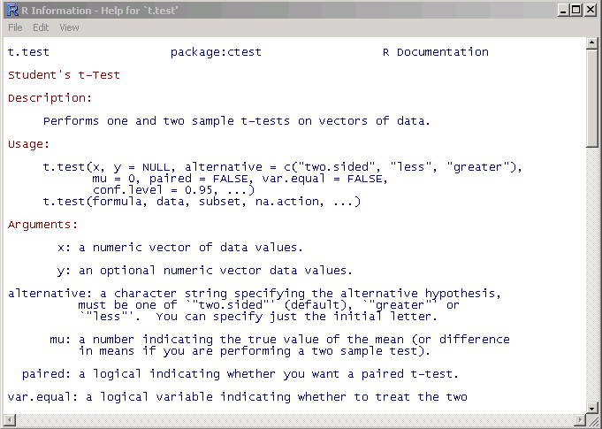
Getting help
Details about a specific command whose name you know (input arguments, options, algorithm, results):
>? t.test
or
>help(t.test)

Slide 26
Grouping, loops and conditional execution
Grouped expressions
R is an expression language in the sense that its only command type is a function or expression which returns a result.
Commands may be grouped together in braces, {expr 1, . . ., expr m}, in which case the value of the group is the result of the last expression in the group evaluated.
Control statements
if statements
The language has available a conditional construction of the form
if (expr 1) expr 2 else expr 3
where expr 1 must evaluate to a logical value and the result of the entire expression is then evident.
a vectorized version of the if/else construct, the ifelse function. This has the form ifelse(condition, a, b)

Slide 27
Repetitive execution
for loops, repeat and while
for (name in expr 1) expr 2
where name is the loop variable. expr 1 is a vector expression, (often a sequence like 1:20), and expr 2 is often a grouped expression with its sub-expressions written in terms of the dummy name. expr 2 is repeatedly evaluated as name ranges through the values in the vector result of expr 1.
Other looping facilities include the
repeat expr statement and the
while (condition) expr statement.
The break statement can be used to terminate any loop, possibly abnormally. This is the only way to terminate repeat loops.
The next statement can be used to discontinue one particular cycle and skip to the “next”.

Slide 28
Branching
if (logical expression) {
statements
} else {
alternative statements
}
else branch is optional

Slide 29
Loops
When the same or similar tasks need to be performed multiple times; for all elements of a list; for all columns of an array; etc.
Monte Carlo Simulation
Cross-Validation (delete one and etc)
for(i in 1:10) {
print(i*i)
}
i=1
while(i<=10) {
print(i*i)
i=i+sqrt(i)
}

Slide 30
lapply, sapply, apply
When the same or similar tasks need to be performed multiple times for all elements of a list or for all columns of an array.
May be easier and faster than “for” loops
lapply(li, function )
To each element of the list li, the function function is applied.
The result is a list whose elements are the individual function results.
> li = list("klaus","martin","georg")
> lapply(li, toupper) # toupper is a function that capitalizes text
> [[1]]
> [1] "KLAUS"
> [[2]]
> [1] "MARTIN"
> [[3]]
> [1] "GEORG"

Slide 31
lapply, sapply, apply
sapply( li, fct )
Like apply, but tries to simplify the result, by converting it into a vector or array of appropriate size
> li = list("klaus","martin","georg")
> sapply(li, toupper)
[1] "KLAUS" "MARTIN" "GEORG"
> fct = function(x) { return(c(x, x*x, x*x*x)) }
> sapply(1:5, fct)
[,1] [,2] [,3] [,4] [,5]
[1,] 1 2 3 4 5
[2,] 1 4 9 16 25
[3,] 1 8 27 64 125

Slide 32
apply
apply( arr, margin, fct )
Apply the function fct along some dimensions of the array arr, according to margin, and return a vector or array of the appropriate size.
> x
[,1] [,2] [,3]
[1,] 5 7 0
[2,] 7 9 8
[3,] 4 6 7
[4,] 6 3 5
> apply(x, 1, sum)
[1] 12 24 17 14
> apply(x, 2, sum)
[1] 22 25 20

Slide 33
functions and operators
Functions do things with data
“Input”: function arguments (0,1,2,…)
“Output”: function result (exactly one)
Example:
add = function(a,b)
{ result = a+b
return(result) }
Operators:
Short-cut writing for frequently used functions of one or two arguments.
Examples: + - * / ! & | %%

Slide 34
functions and operators
Functions do things with data
“Input”: function arguments (0,1,2,…)
“Output”: function result (exactly one)
Exceptions to the rule:
Functions may also use data that sits around in other places, not just in their argument list: “scoping rules”*
Functions may also do other things than returning a result. E.g., plot something on the screen: “side effects”
* Lexical scope and Statistical Computing.
R. Gentleman, R. Ihaka, Journal of Computational and Graphical Statistics, 9(3), p. 491-508 (2000).

Slide 35
Reading data from files
The read.table() function
To read an entire data frame directly, the external file will normally have a special form.
The first line of the file should have a name for each variable in the data frame.
Each additional line of the file has its first item a row label and the values for each variable.
Price Floor Area Rooms Age Cent.heat
01 52.00 111.0 830 5 6.2 no
02 54.75 128.0 710 5 7.5 no
03 57.50 101.0 1000 5 4.2 no
04 57.50 131.0 690 6 8.8 no
05 59.75 93.0 900 5 1.9 yes
...
numeric variables and nonnumeric variables (factors)

Slide 36
Reading data from files
HousePrice <- read.table("houses.data", header=TRUE)
Price Floor Area Rooms Age Cent.heat
52.00 111.0 830 5 6.2 no
54.75 128.0 710 5 7.5 no
57.50 101.0 1000 5 4.2 no
57.50 131.0 690 6 8.8 no
59.75 93.0 900 5 1.9 yes
...
The data file is named ‘input.dat’.
Suppose the data vectors are of equal length and are to be read in in parallel.
Suppose that there are three vectors, the first of mode character and the remaining two of mode numeric.
The scan() function
inp<- scan("input.dat", list("",0,0))
To separate the data items into three separate vectors, use assignments like
label <- inp[[1]]; x <- inp[[2]]; y <- inp[[3]]
inp <- scan("input.dat", list(id="", x=0, y=0)); inp$id; inp$x; inp$y

Slide 37
Storing data
Every R object can be stored into and restored from a file with the commands “save” and “load”.
This uses the XDR (external data representation) standard of Sun Microsystems and others, and is portable between MS-Windows, Unix, Mac.
> save(x, file=“x.Rdata”)
> load(“x.Rdata”)

Slide 38
Importing and exporting data
There are many ways to get data into R and out of R.
Most programs (e.g. Excel), as well as humans, know how to deal with rectangular tables in the form of tab-delimited text files.
> x = read.delim(“filename.txt”)
also: read.table, read.csv
> write.table(x, file=“x.txt”, sep=“\t”)

